Slide 1

Android Installation & Project Creation

Slide 2
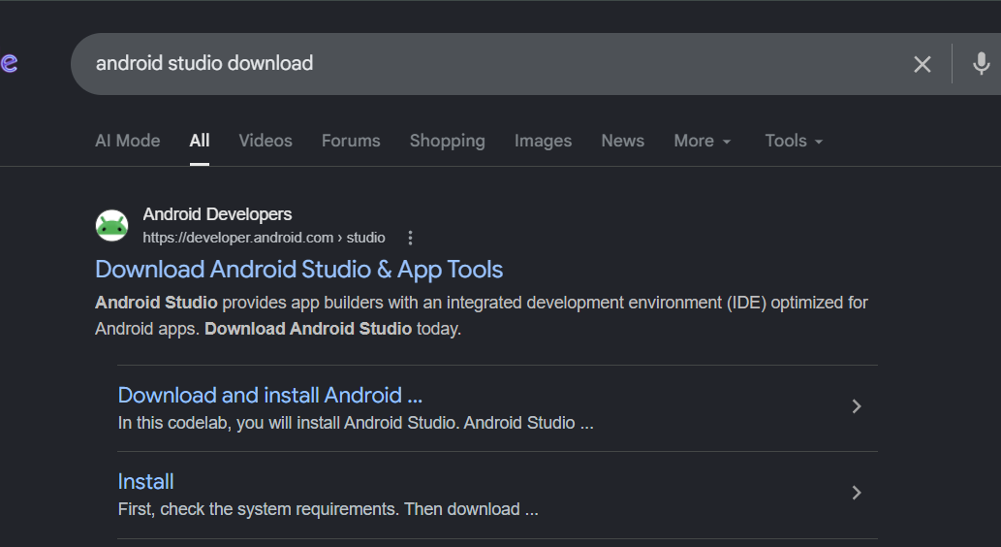
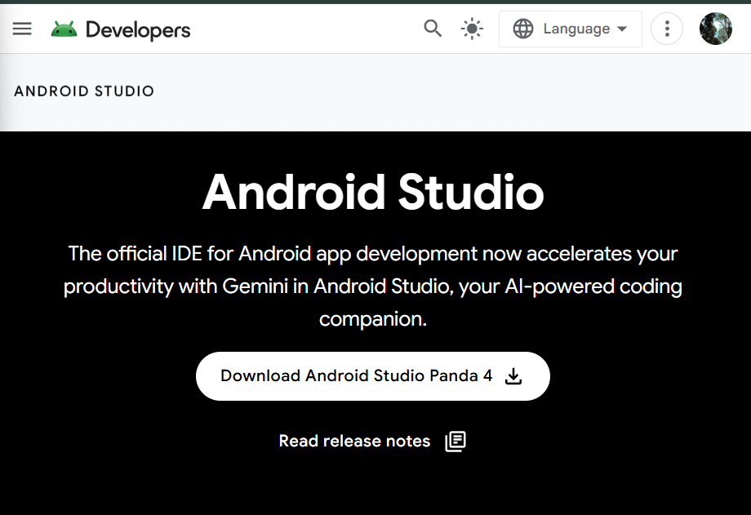
INSTALLATION SETUPS
Go to the official website:
Android Studio Official Website

Slide 3
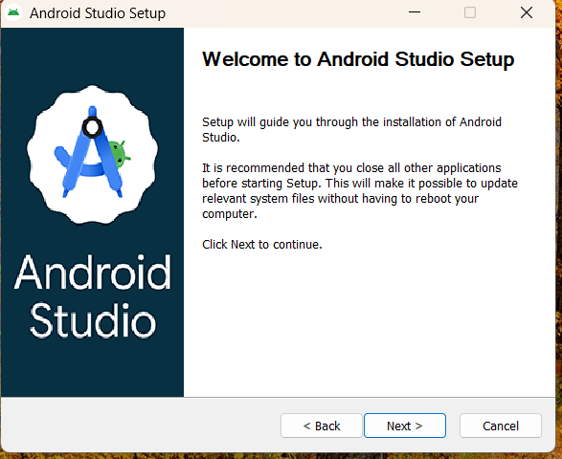
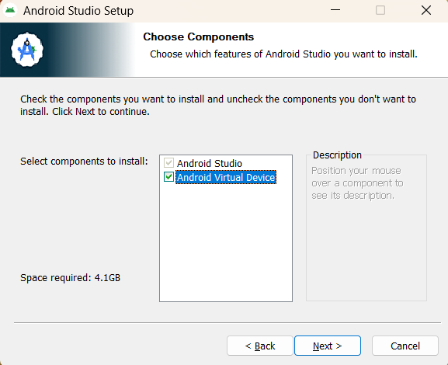
2 . Install Android Studio
Step 1 — Download Installer
Click Download Android Studio

Slide 4
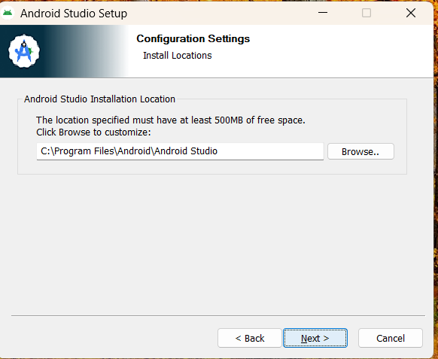
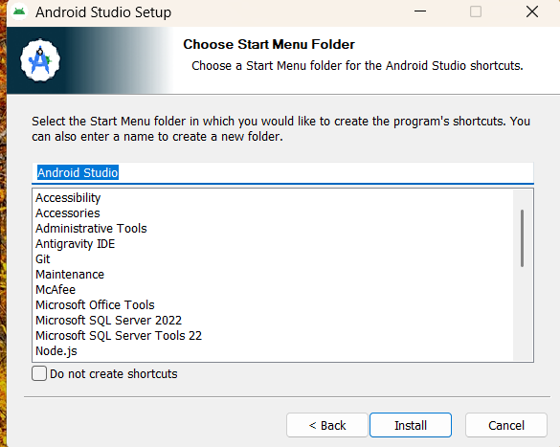

Slide 5
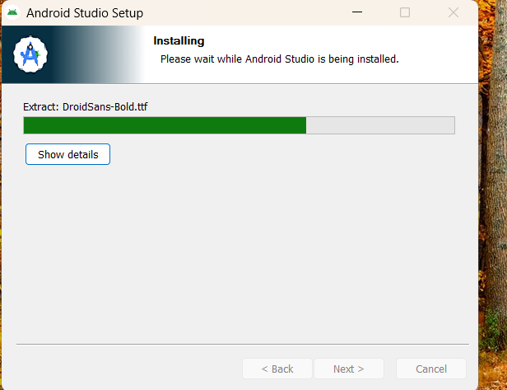
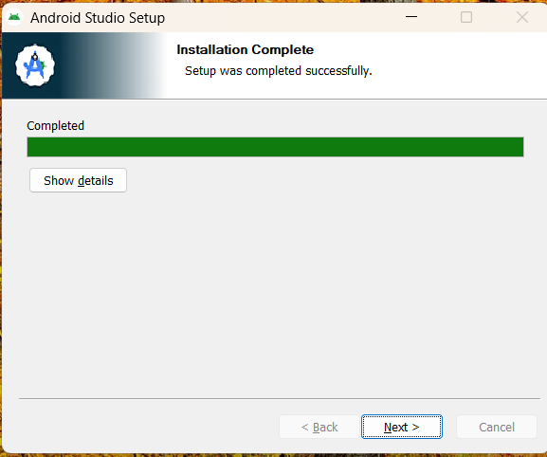
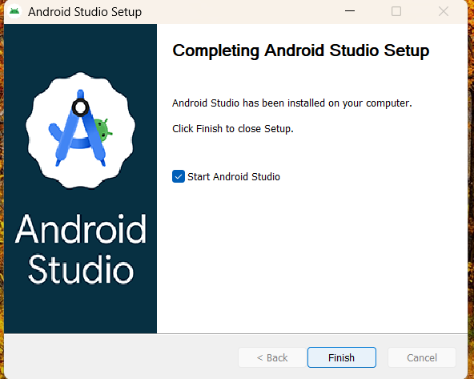

Slide 6
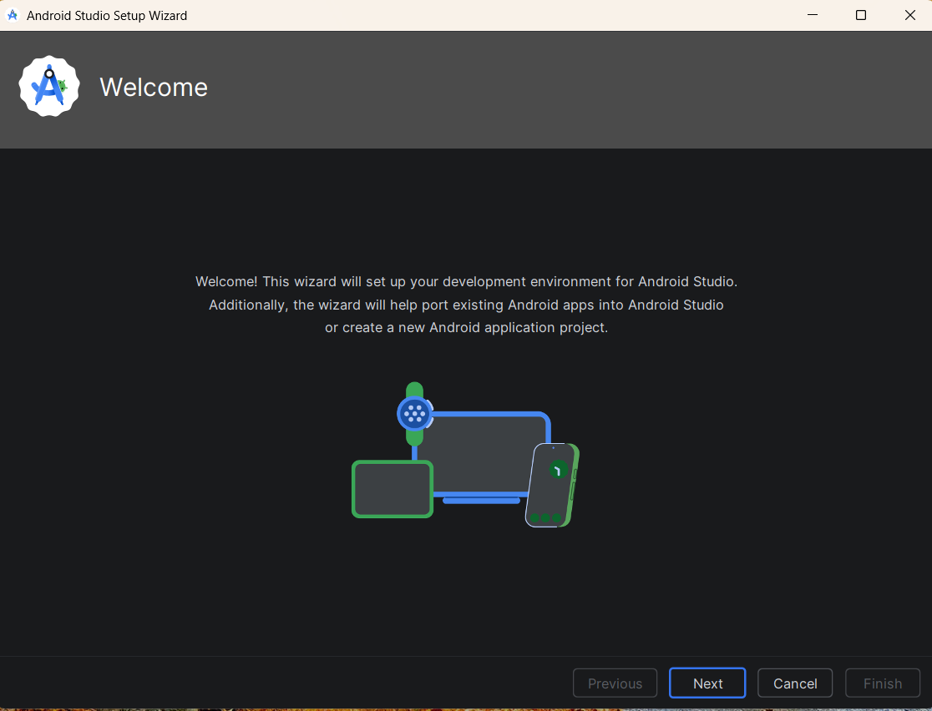
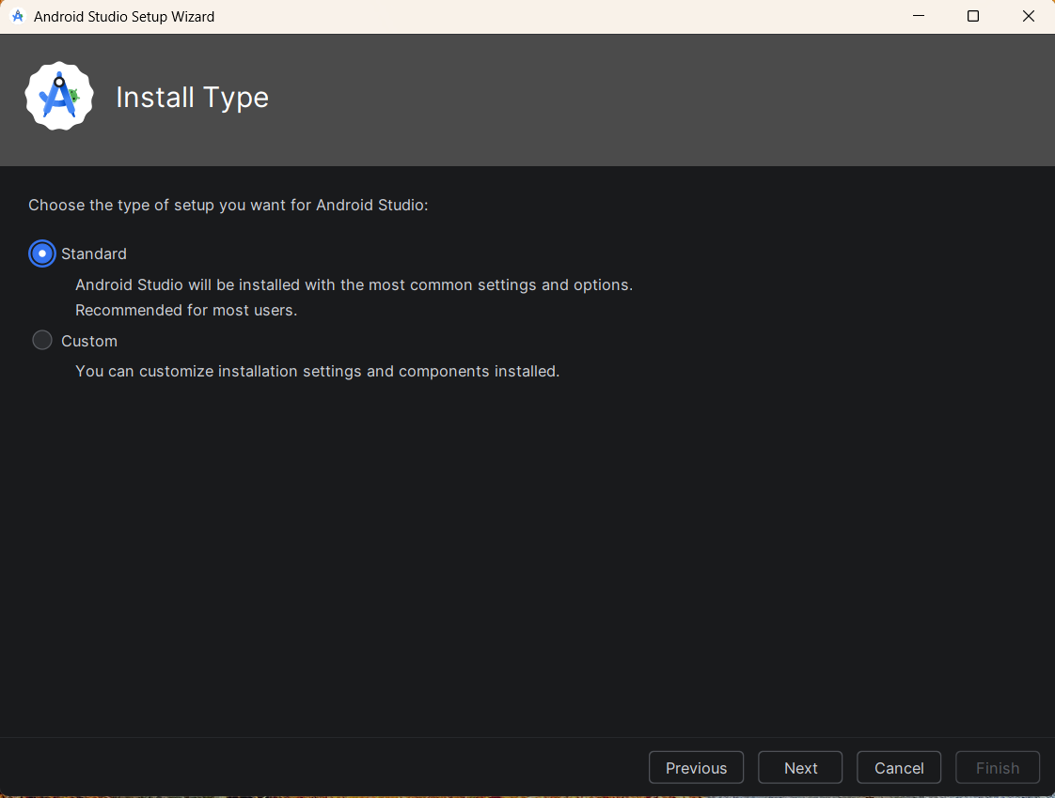
Keep the Install type standard

Slide 7
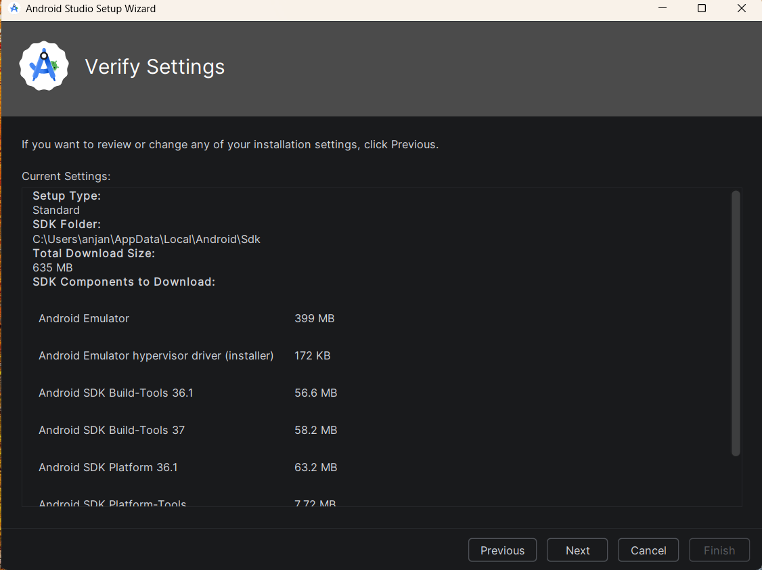
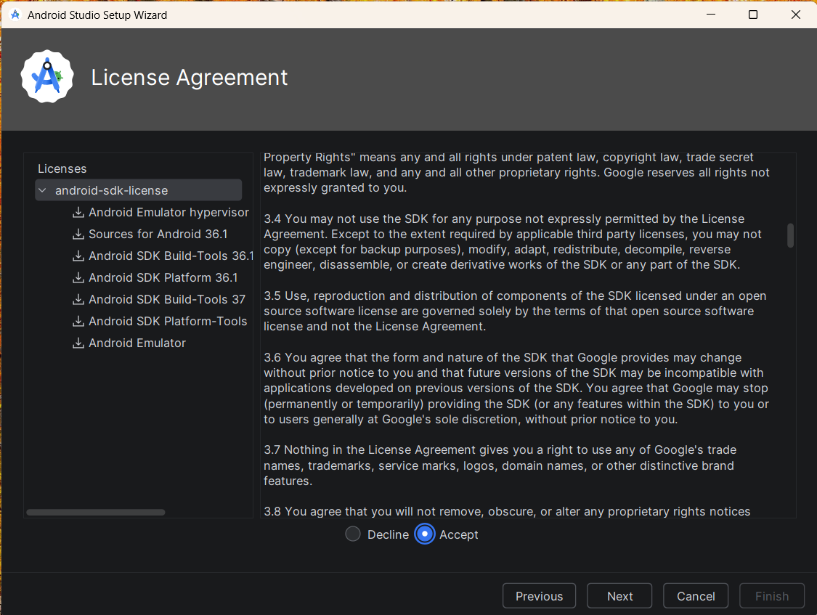

Slide 8
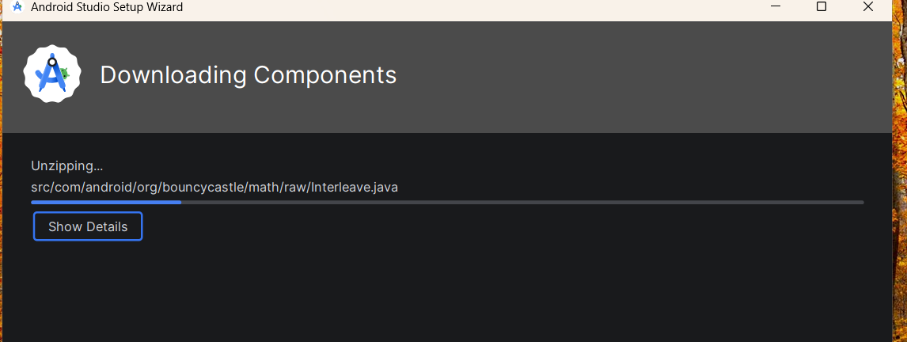
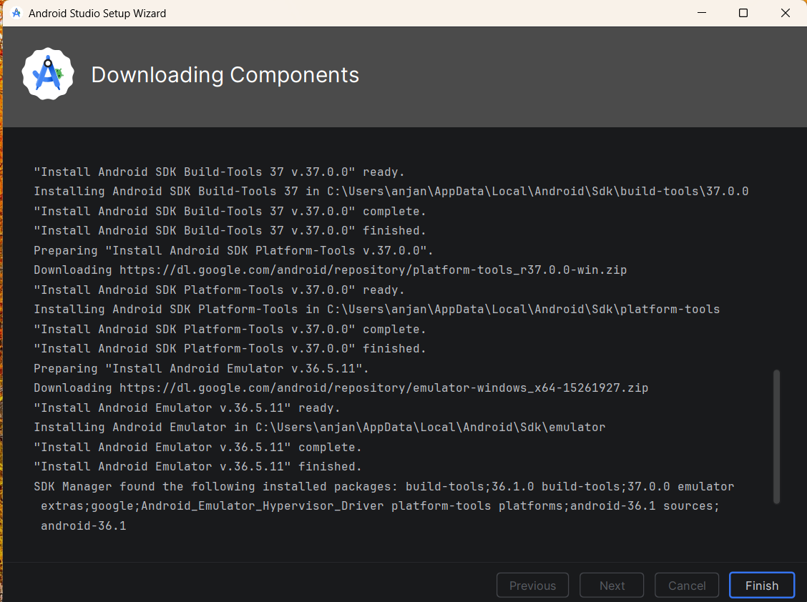

Slide 9
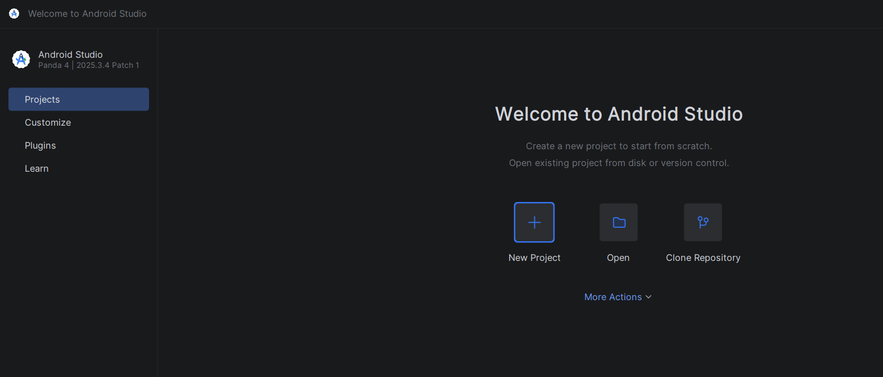
Project Creation
Create new Project using New Project(+) icon

Slide 10
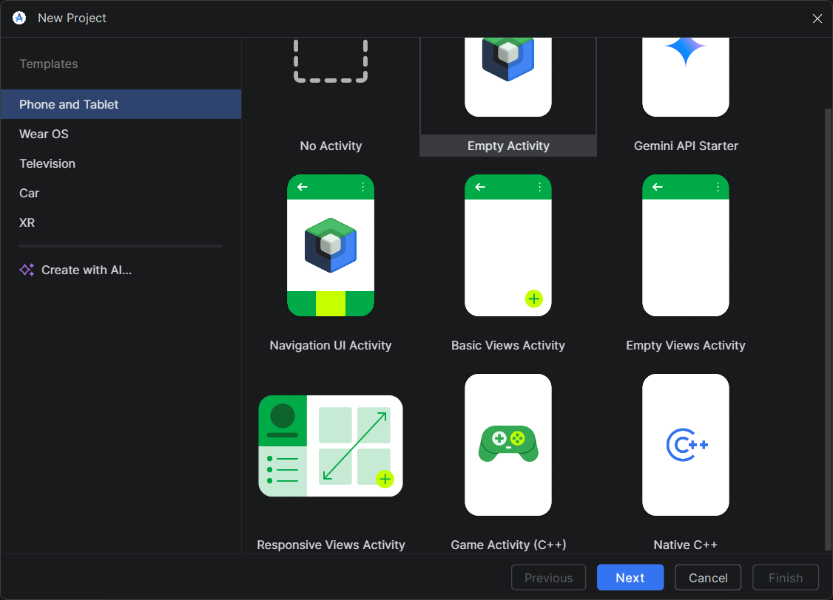
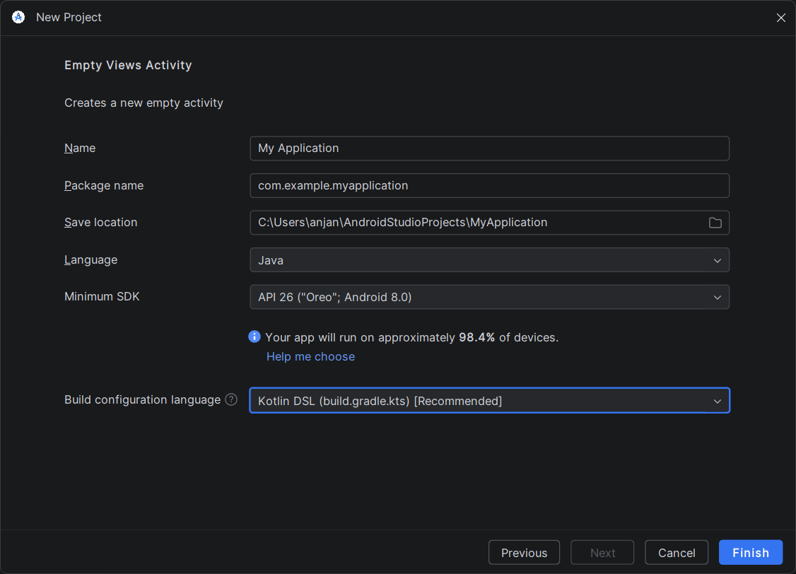
Select the Empty views Activity and click the next
Enter your Project name
Select the language and minimum sdk same as the given image

Slide 11
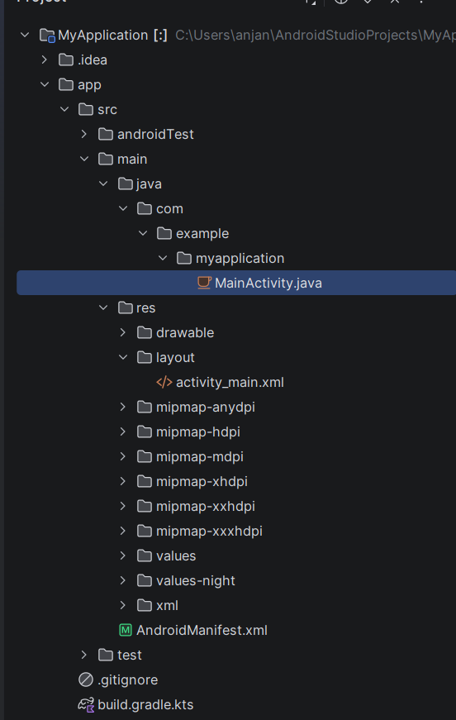
src → Contains all source files of the project
main → Main application code and resources
java → Contains Java programming files
com.example.myapplication → Package name of the app
MainActivity.java → Main screen logic/controller
res → Resources folder for UI and app assets
drawable → Images and drawable files
layout → XML UI design files

Slide 12
activity_main.xml → Design of the main screen
mipmap-* → App launcher icons for different screen sizes
values → Colors, strings, themes, dimensions
xml → Additional XML configuration files
AndroidManifest.xml → App configuration and permissions
test → Unit testing files
.gitignore → Files ignored by Git
build.gradle.kts → Project build configuration file

Slide 13

Build tools : Running projects and Compiling code
Diamond icons : Code generation and its depend on installed extension
Github : Github Integration and Repository Management
Problems : Show errors / warnings in code
Commad Line : give text commands directly to your computer or project inside Android Studio.

